Slide 1
StockTrendAI Stock Market Forecasting Model
Abhishek pal

Slide 2
Contents
What is Stock Market?
Why to predict Stock Price?
Method: LSTM
Dataset
Results
Conclusion

Slide 3
What is Stock Market?
The Stock Market refers to public markets that exist for issuing, buying, and selling stocks that trade on a stock exchange or over-the-counter.
Stocks, also known as equities, represent fractional ownership in a company, and the stock market is a place where investors can buy and sell ownership of such investible assets.

Slide 4
Why to predict Stock Price?
To eliminate the uses of Fundamental Analysis(Long Term).
To eliminate the uses of Technical Analysis(Short Term).
To eliminate the uses of Quantitative Analysis(Historic Data)

Slide 5
Method: LSTM
LSTM stands for Long Short Term Memory.
It is a model that extends the memory of Recurrent Neural Networks (RNN), which is capable of learning long term dependencies.
It is capable of capturing the patterns of both long term such as a yearly pattern and short term such as weekly or daily patterns.

Slide 6
Why to use LSTM?
Using LSTM, time series forecasting models can predict future values based on previous, sequential data and it is proven to be extremely effective.
The reason they work so well is that LSTM can store past important information and forget the information that is not.
The different gates inside LSTM boost its capability for capturing non-linear relationships for forecasting.

Slide 7
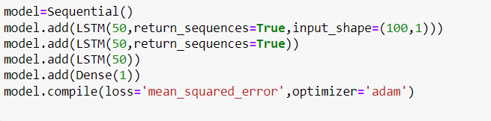
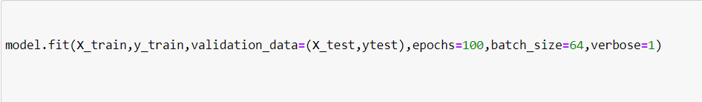
LSTM Model

Slide 8
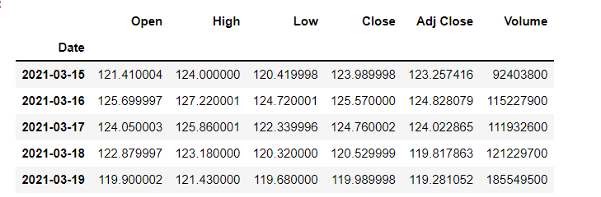
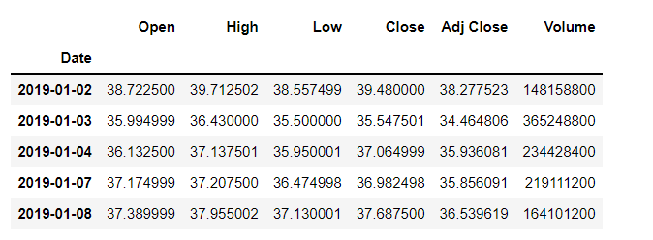
Dataset
Apple Last 1 year
Apple
Train Data: 70%
Test Data: 30%

Slide 9
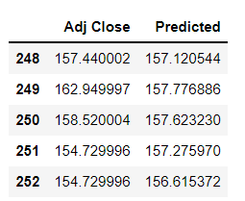
Results
Apple Stock of Last 1 Year(3/15/24 to 3/11/25)
MAE: 4.11
MSE: 27.17
RMSE: 5.21

Slide 10
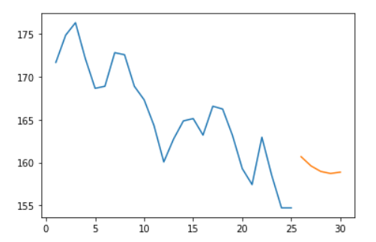
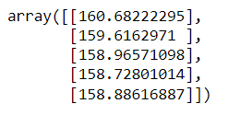
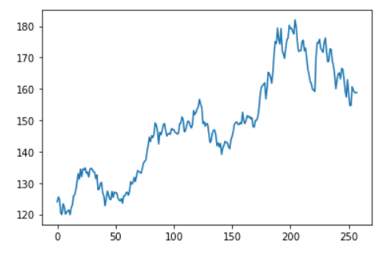
Prediction of Next 5 Days

Slide 11
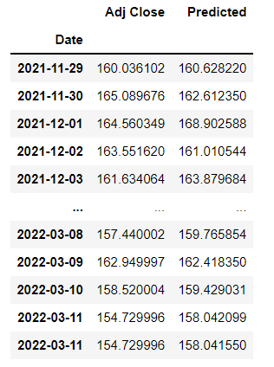
Results[Continue]
Apple Stock From 1/1/20 to 3/11/25
MAE: 7.34
MSE: 76.74
RMSE: 8.76

Slide 12
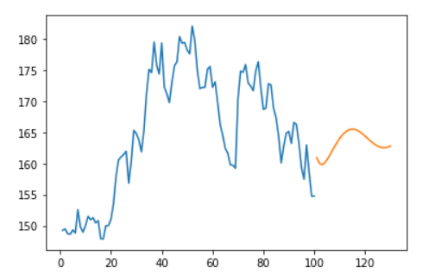
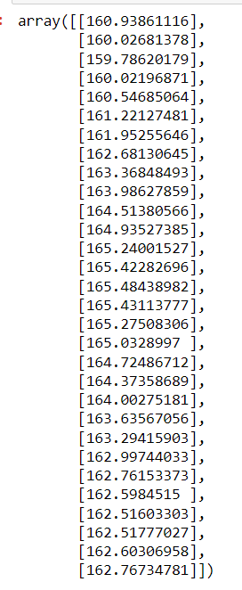
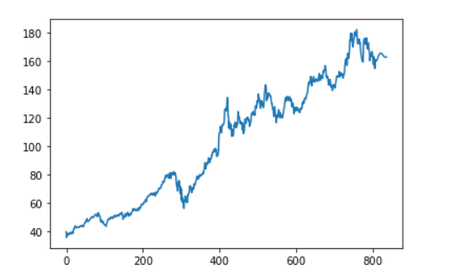
Prediction of Next 30 Days

Slide 13
Conclusion
We don't need the exact stock values of the future, but the stock price movements, i.e. if it is going to rise or fall in the near future.
This LSTM model predict the data in smooth curve.
This LSTM model predict data with MAE,RMSE between 4 to 8 which is efficient to predict accurate price.

Slide 14
THANK YOU!

